Slide 1
Unit -4
MongoDB
Advanced Web Technology
Dept. of Computer Engineering

Slide 2
Content
Introduction and Overview of MongoDB,
MongoDB Installation,
CRUD Operation in MongoDB,
Data Modeling, Storage Classes,
Indexing and Performance Considerations,
Aggregation,
MongoDB Replication

Slide 3
Introduction and Overview of MongoDB
MongoDB, the most popular NoSQL database, is an open-source document-oriented database. The term ‘NoSQL’ means ‘non-relational’. It means that MongoDB isn’t based on the table-like relational database structure but provides an altogether different mechanism for storage and retrieval of data. This format of storage is called BSON ( similar to JSON format).

Slide 4
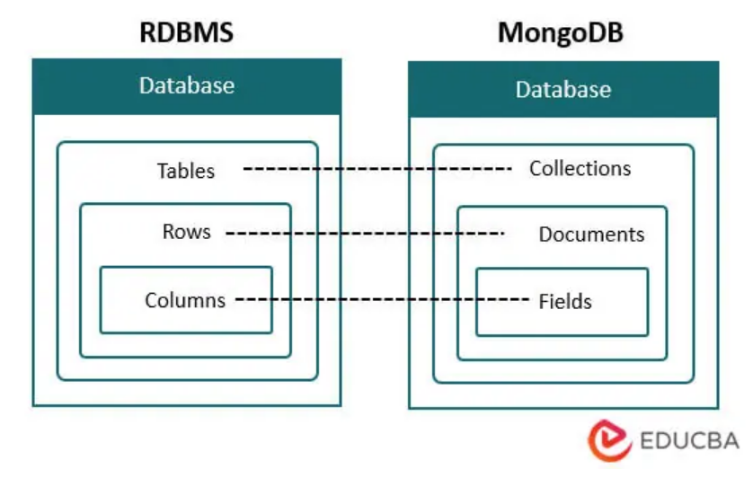

Slide 5
MongoDB is a document-oriented NoSQL database system that provides high scalability, flexibility, and performance.
Unlike standard relational databases, MongoDB stores data in a JSON document structure form.
This makes it easy to operate with dynamic and unstructured data and MongoDB is an open-source and cross-platform database System.

Slide 6
Database
Database is a container for collections.
Each database gets its own set of files.
A single MongoDB server can has multiple databases.

Slide 7
Collection
Collection is a group of documents.
Collection is equivalent to RDBMS table.
A collection consist inside a single database.
Collections do not enforce a schema.
A Collection can have different fields within a Documents.

Slide 8
Why Use MongoDB?
Index on any attribute: Indexing in MongoDB allows for faster data retrieval by creating a searchable structure on selected attributes, optimizing query performance.
Replication and high availability: MongoDB’s replica sets ensure data redundancy by maintaining multiple copies of the data, providing fault tolerance and continuous availability even in case of server failures.
Auto-Sharding: Auto-sharding in MongoDB automatically distributes data across multiple servers, enabling horizontal scaling and efficient handling of large datasets.

Slide 9
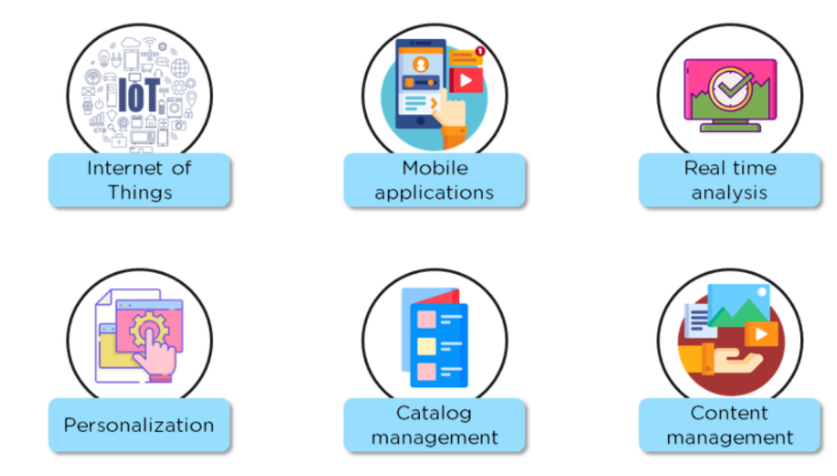

Slide 10
MongoDB installation
For intalling in your local windows system.
https://www.geeksforgeeks.org/how-to-install-mongodb-on-windows/
For mongo atlas cloud
https://youtu.be/NQN7KiNYgg0

Slide 11
CRUD operations in mongodb
To perform certain operations like entering new data into the application, updating data into the application, deleting data from the application, and reading the data of the application. MongoDB provides a set of some basic but most essential operations that will help you to easily interact with the MongoDB server and these operations are known as CRUD operations.

Slide 12
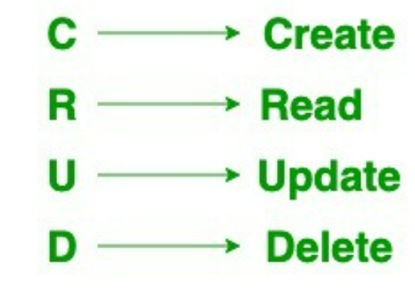

Slide 13
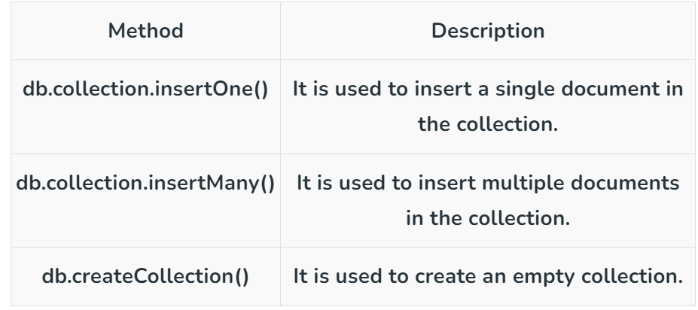
Create
The create or insert operations are used to insert or add new documents in the collection. If a collection does not exist, then it will create a new collection in the database.

Slide 14
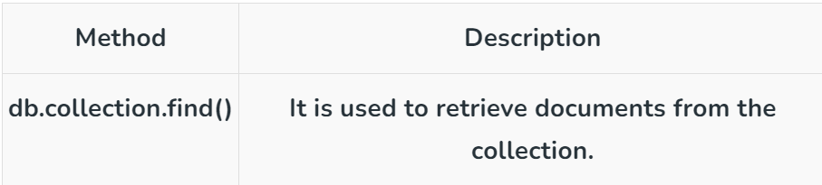
Read
The Read operations are used to retrieve documents from the collection, or in other words, read operations are used to query a collection for a document.

Slide 15
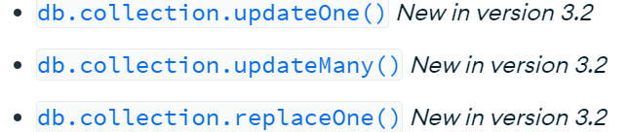
Update
Update operations modify existing documents in a collection. MongoDB provides the following methods to update documents of a collection:

Slide 16
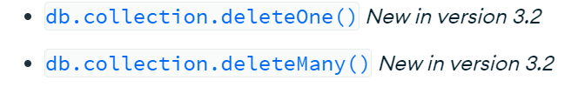
Delete
Delete operations remove documents from a collection. MongoDB provides the following methods to delete documents of a collection:

Slide 17
Data modelling in MongoDB
Data modeling is the process of creating a visual representation of either a whole information system or parts of it to communicate connections between data points and structures.
MongoDB provides two types of data models: — Embedded data model and Normalized data model. Based on the requirement, you can use either of the models while preparing your document.

Slide 18
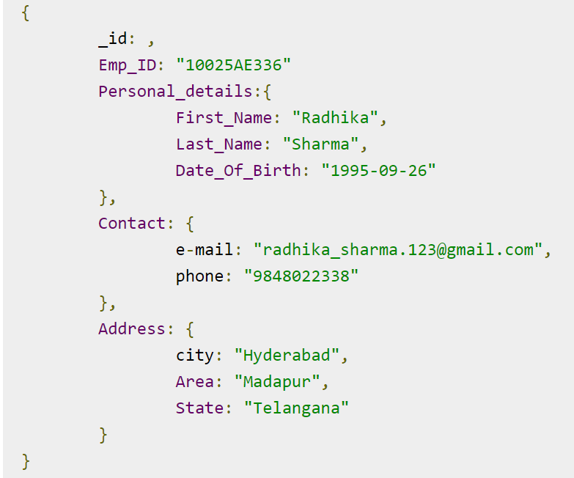
Embedded Data Model
In this model, you can have (embed) all the related data in a single document, it is also known as de-normalized data model.

Slide 19
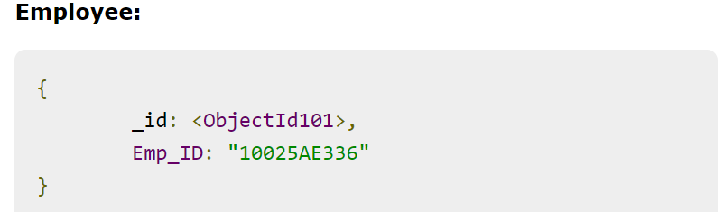
Normalized Data Model
In this model, you can refer the sub documents in the original document, using references. For example, you can re-write the above document in the normalized model as:

Slide 20
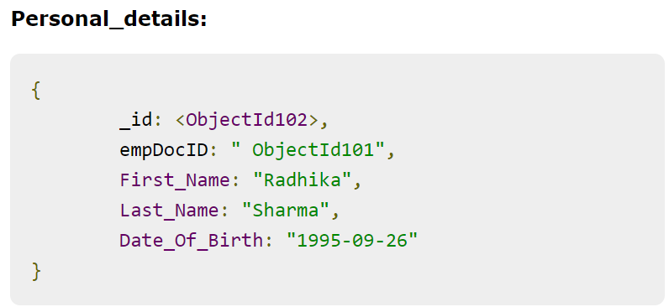

Slide 21
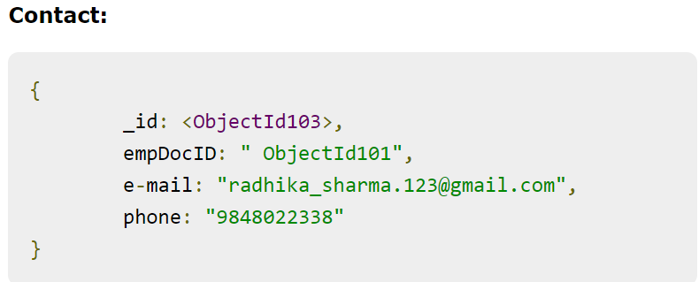

Slide 22
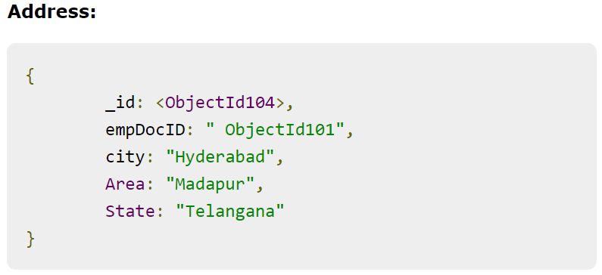

Slide 23
Storage Classes
In MongoDB, storage classes refer to the various storage engines and configurations available for managing data storage and retrieval. MongoDB supports multiple storage engines, each with its own characteristics and trade-offs. MongoDB primarily offers two storage engines: WiredTiger and MMAPv1. However, please note that MongoDB evolves over time, and new storage engines or changes to existing ones may have occurred since then.
Here's an explanation of the two main storage engines in MongoDB:

Slide 24
Storage Classes
WiredTiger (default as of MongoDB 3.2):
WiredTiger is the default storage engine in MongoDB since version 3.2. It is designed for high performance and scalability while maintaining ACID (Atomicity, Consistency, Isolation, Durability) properties.
Key features of WiredTiger include document-level concurrency control, support for compression, and support for various data structures like B-trees.
WiredTiger is generally recommended for most use cases because of its performance and efficiency improvements over the older MMAPv1 engine.

Slide 25
Storage Classes
MMAPv1 (Memory-Mapped Files, no longer the default as of MongoDB 3.2):
MMAPv1 was the original storage engine in MongoDB. It works by memory-mapping data files directly to RAM, which means it relies heavily on the operating system's virtual memory management.
It is a simple storage engine that uses copy-on-write for updates, which can lead to fragmentation over time.
While MMAPv1 is not as performant as WiredTiger for most workloads, it may still be suitable for specific use cases or older MongoDB deployments.

Slide 26
Indexing and Performance Considerations
Indexing is a crucial concept in MongoDB, as it significantly impacts query performance and the efficiency of data retrieval operations. Properly designed and maintained indexes can significantly improve the speed of queries, while improper indexing can lead to performance problems. Here, I'll explain indexing and some performance considerations in MongoDB:
Indexing in MongoDB:
What is an Index?
An index in MongoDB is a data structure that stores a small portion of the data in a collection in an efficient, easily searchable form.
Indexes are created on one or more fields within a collection and allow MongoDB to quickly locate and retrieve documents based on the indexed fields.

Slide 27
Indexing and Performance Considerations
Types of Indexes:
MongoDB supports various types of indexes, including single-field indexes, compound indexes (indexing multiple fields together), multikey indexes (for arrays), geospatial indexes, and more.
Creating Indexes:
You can create indexes using the createIndex() method or by specifying them in a collection's schema (for Mongoose, a popular MongoDB driver for Node.js).

Slide 28
Indexing and Performance Considerations
Performance Considerations:
Indexing Strategy:
Choose the fields to index carefully based on your application's query patterns. Index only the fields that are frequently used in queries and sorting.
Avoid over-indexing, as it can lead to increased storage requirements and slower write operations.
Index Selectivity:
Highly selective indexes are preferred. A highly selective index contains a wide range of values, which narrows down the search quickly. Conversely, a low selectivity index contains many duplicate values, making it less effective.
Index Size:

Slide 29
Indexing and Performance Considerations
Indexes consume storage space. It's essential to balance the performance gains from indexing with the increased storage requirements. Consider factors like the size of your data, available disk space, and query performance.
Index Maintenance:
Regularly monitor and maintain your indexes. MongoDB provides tools like the db.collection.reIndex() command and the Index Intersection feature to help manage indexes efficiently.

Slide 30
Covered Queries:
A covered query is one where all the fields needed for a query are part of an index, eliminating the need for MongoDB to access the documents themselves. This can significantly improve query performance.

Slide 31
Index Hints:
MongoDB allows you to specify index hints to influence query execution plans. Use hints when you have a good understanding of your data and query patterns.
Query Optimization
Use the explain() method to analyze query execution plans and identify areas for optimization. Adjust your queries or indexes based on this analysis.

Slide 32
Sharding:
For large datasets, consider sharding your MongoDB cluster. Sharding distributes data across multiple servers and can improve query performance by parallelizing data retrieval.
Hardware and Resources:
Ensure that your hardware resources (CPU, RAM, and disk) are appropriately sized for your MongoDB workload to avoid resource bottlenecks.

Slide 33
Regular Backups and Maintenance:
Regularly backup and optimize your database to ensure long-term performance. Use tools like mongodump and mongorestore for backups and consider periodic compaction for storage efficiency.

Slide 34
Profiling and Monitoring:
Implement profiling and monitoring tools to gain insights into the performance of your MongoDB deployment. Tools like MongoDB Atlas, MMS, or third-party monitoring solutions can be helpful.
MongoDB's performance considerations are highly dependent on your specific use case, dataset size, query patterns, and hardware configuration. It's crucial to monitor your system's performance continuously and make adjustments as needed to maintain optimal performance over time.

Slide 35
Aggregation
In MongoDB, aggregation operations process the data records/documents and return computed results. It collects values from various documents and groups them together and then performs different types of operations on that grouped data like sum, average, minimum, maximum, etc to return a computed result. It is similar to the aggregate function of SQL.
MongoDB provides three ways to perform aggregation
Aggregation pipeline
Map-reduce function
Single-purpose aggregation

Slide 36
You can refer to the below links for aggregation in mongodb:
https://www.geeksforgeeks.org/aggregation-in-mongodb/
https://studio3t.com/knowledge-base/articles/mongodb-aggregation-framework/#:~:text=What%20is%20Aggregation%20in%20MongoDB,that%20pass%20through%20the%20pipeline.

Slide 37
MongDB Replication
MongoDB replication is a fundamental feature that provides data redundancy, high availability, and fault tolerance in MongoDB deployments. It ensures that data is reliably and automatically copied to multiple servers, allowing for failover and data recovery in case of hardware failures or other issues. MongoDB replication is achieved through a mechanism called a replica set.

Slide 38
How do I enable replication in MongoDB?
To start, you’ll need MongoDB installed on three or more nodes. Each of the nodes in the cluster will need to be able to communicate with the others over a standard port (27017 by default). Additionally, each replica set member needs to have a hostname that is resolvable from the others.

Slide 39
Thank You

